Slide 1
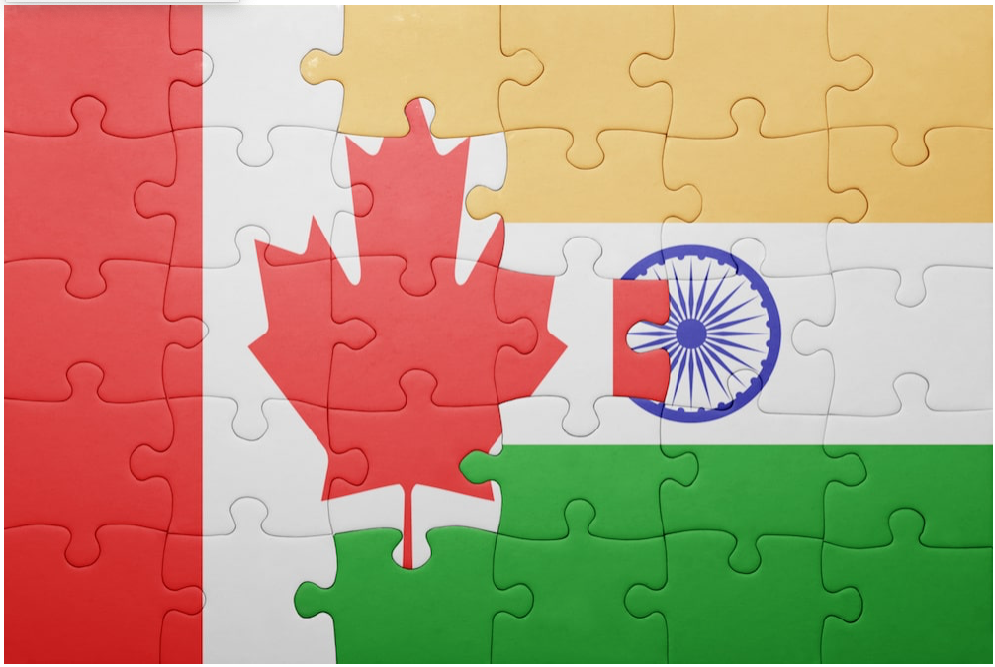
Relocation Recommendation from Delhi to Toronto
Battle of Neighborhoods(Capstone)

Slide 2
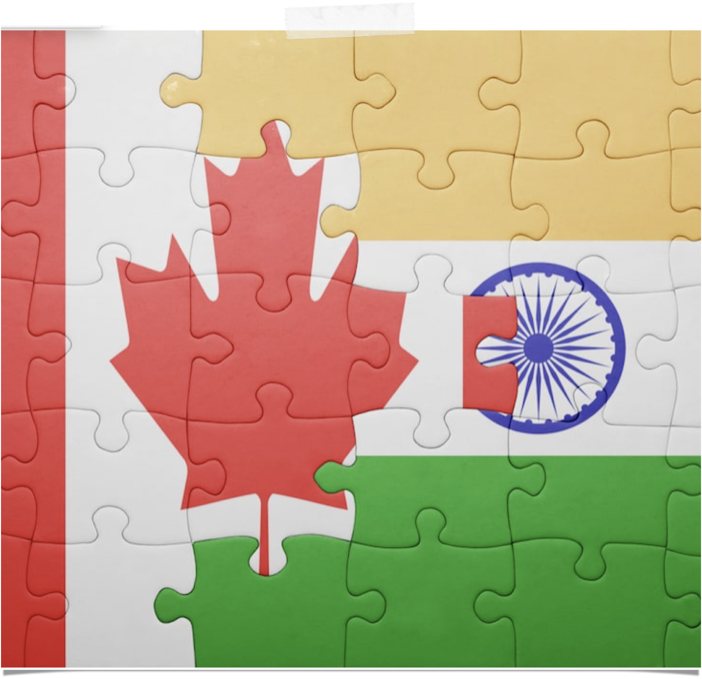
Contents
Introduction to Problem
Data Selection and Preparation
METHODOLOGY
RESULTS
DISCUSSION
CONCLUSION

Slide 3
Introduction
We need to find locations(Neighbourhood) that have a similar nearby venues in Toronto compared to persons native Neighbourhood in Delhi. Also, we need locations that are close to Work/Study location in Toronto. We will use our data science powers to generate a few most promising neighbourhoods based on this criteria. Advantages of each area will then be clearly Expressed so that best possible final location can be chosen.

Slide 4

DATA SeLection and preparation
Borough nearby Office/University location in the city of Toronto.
FOR OUR PROJECT PURPOSE WE ASSUME THAT THESE BOROUGHS ARE NORTH YORK AND SCARBOROUGH
Similar neighbourhood in Toronto as in Delhi.
Picking up data pertinent to following factors:
Neighbourhood: Name of the neighbourhood in the Borough.
Name of the Borough.
Latitude of the Borough.
Longitude of the Borough.

Slide 5
In our project we will gather and process data with following techniques:
Acquire the names and boroughs of the neighbourhoods by scrapping a wikipedia pages and assigning them in “csv" coded data frames.
After we have the names of all the neighbourhoods, we will geocode them using the geopy.geocoder (Nominatim). And thus will add longitude and latitude data corresponding to borough location and neighbourhood data.
Next, we use the foursquare API to find all types of venues within a 500 meter radius for every neighbourhood. Then these are merged with the existing data set
Normalise the data using one hot coding and finally preparing it for cluster formation.
Merging the One hot Coded data and the Most Frequent venue data for proper visualisation of problem.

Slide 6
RESULTS

Slide 7
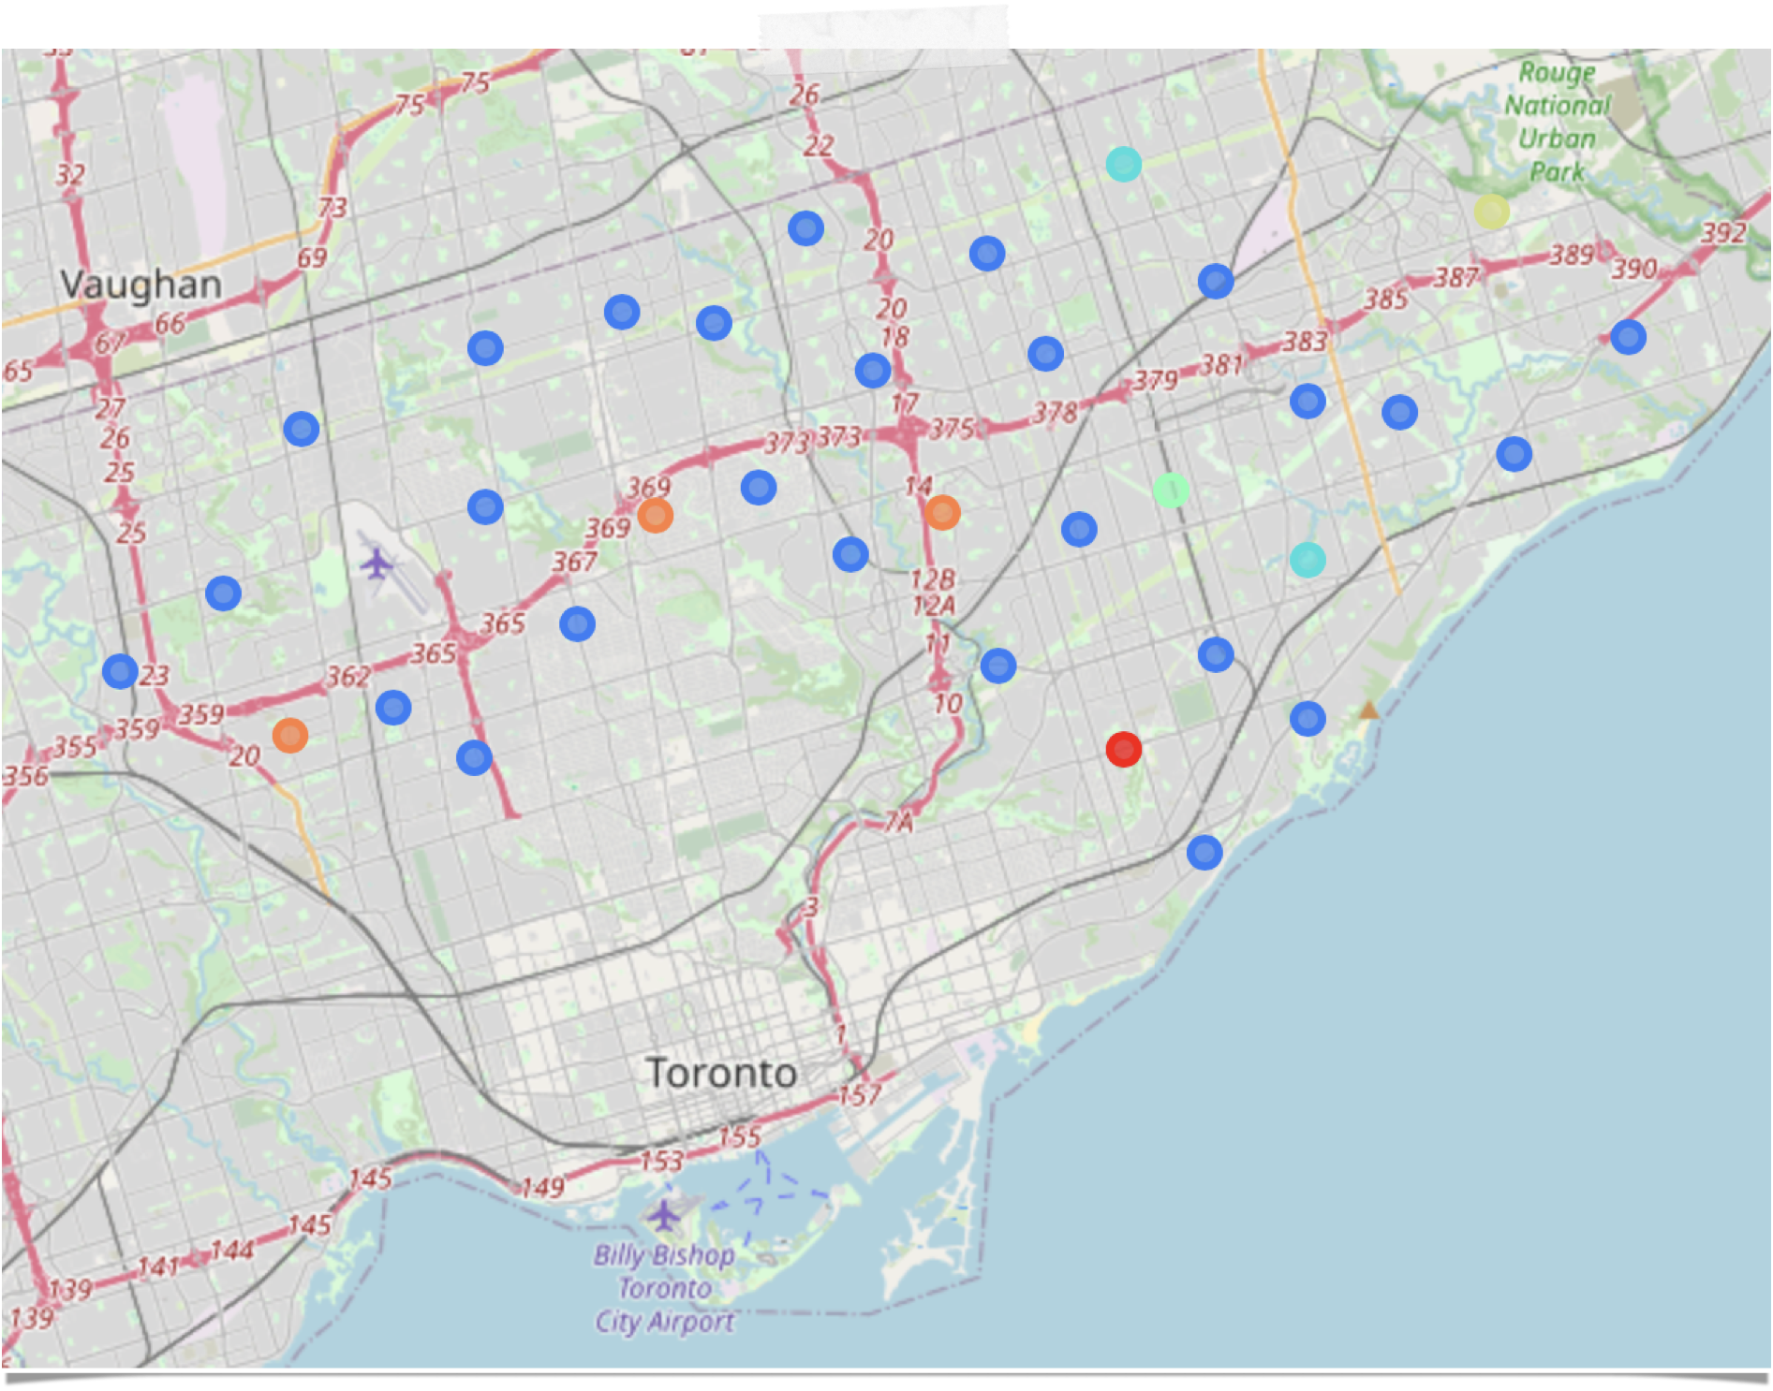
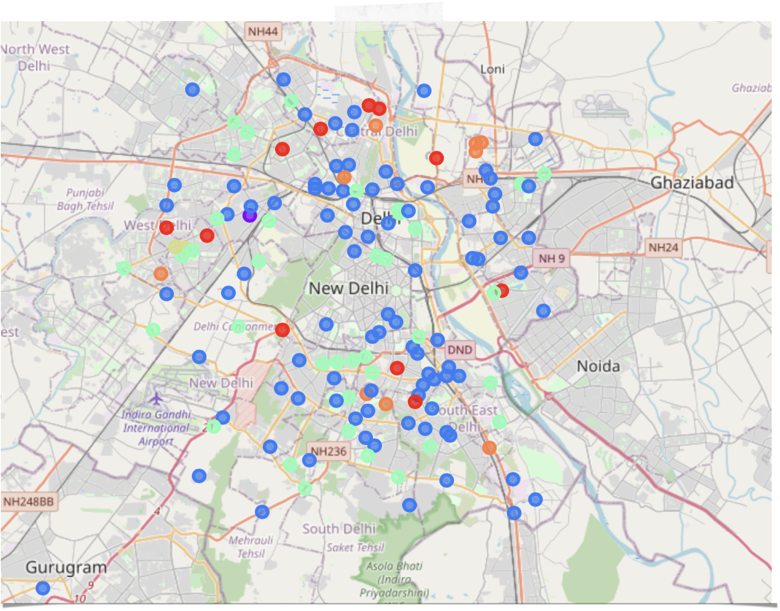
COLOUR -CODED CLUSTERS
Similar neighbourhood with same colour in both Cities

Slide 8
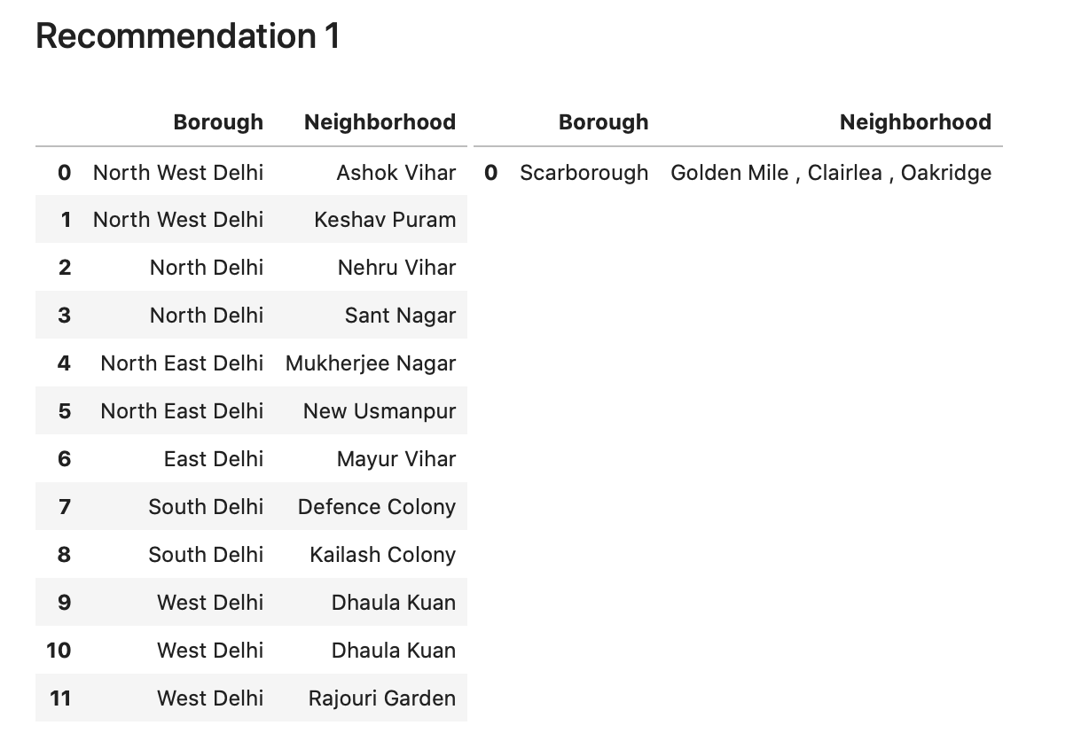

For native Neighbourhoods in Left
Toronto neighbourhoods recommendation in Right
These are in Toronto

Slide 9


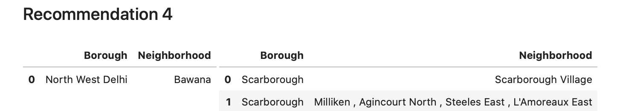
For some-one in Kirti Nagar
Humber Summit is best relocation
For some-one in Bawana
Scarborough Village and Miliken etc are best relocations

Slide 10
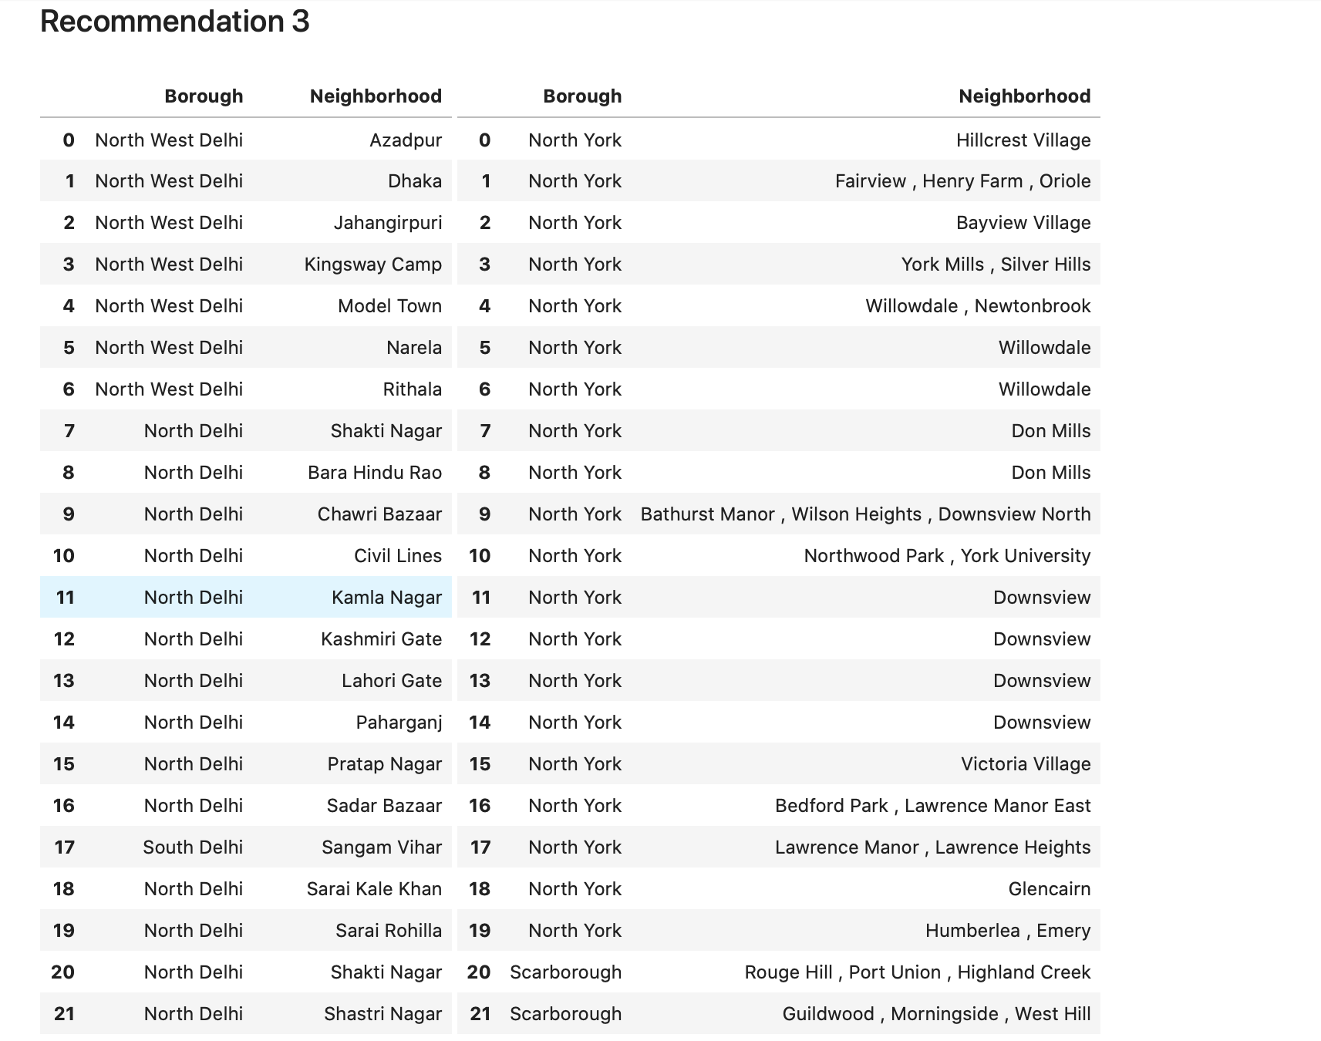
Similarly

Slide 11
An Important Note
The neighbourhoods recommendation obtained here are not completely accurate.
This is due to the limitations in the dataset used in the project. Due to lack of cross referencing sources, we may have missed a few neighbourhoods from our consideration.
The foursquare API does not contain, or does not rely, a comprehensive dataset about the Venues present in Delhi. Surely, in a city like Delhi with a population of over 19 million, there are much more criteria which should have been taken into account.
Also in this study no cultural, and social background of particular parties were taken into account thus making this study over-generalised.

Slide 12

Conclusion
It is always helpful to make use of technology to stay one step ahead i.e. finding out more about places before moving into a neighbourhood.
The future of this project includes taking other factors such as cost of living in the areas into consideration to shortlist the borough, such as filtering areas based on a predefined budget. Thus more personalisation according to each migrant can be easily approached.
Also, the resulted neighbourhood recommendation in Toronto can act as a good starting point for figuring out which location might suit best to a migrant. Each person then, by his personal preferences can further refine the study and take benefits of initial iterations provided in this Project.

